Slide 1

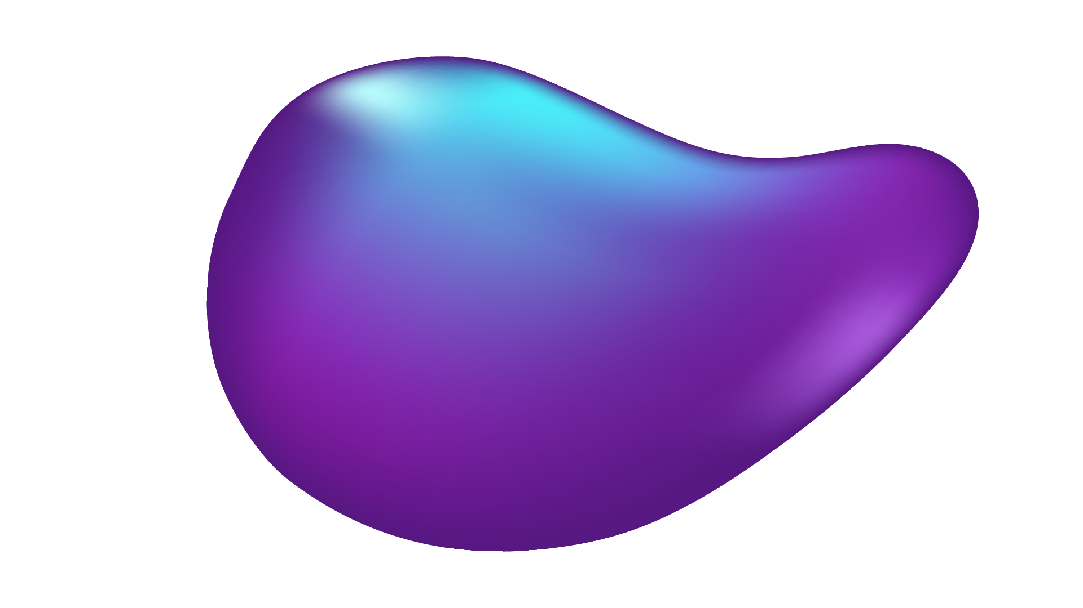
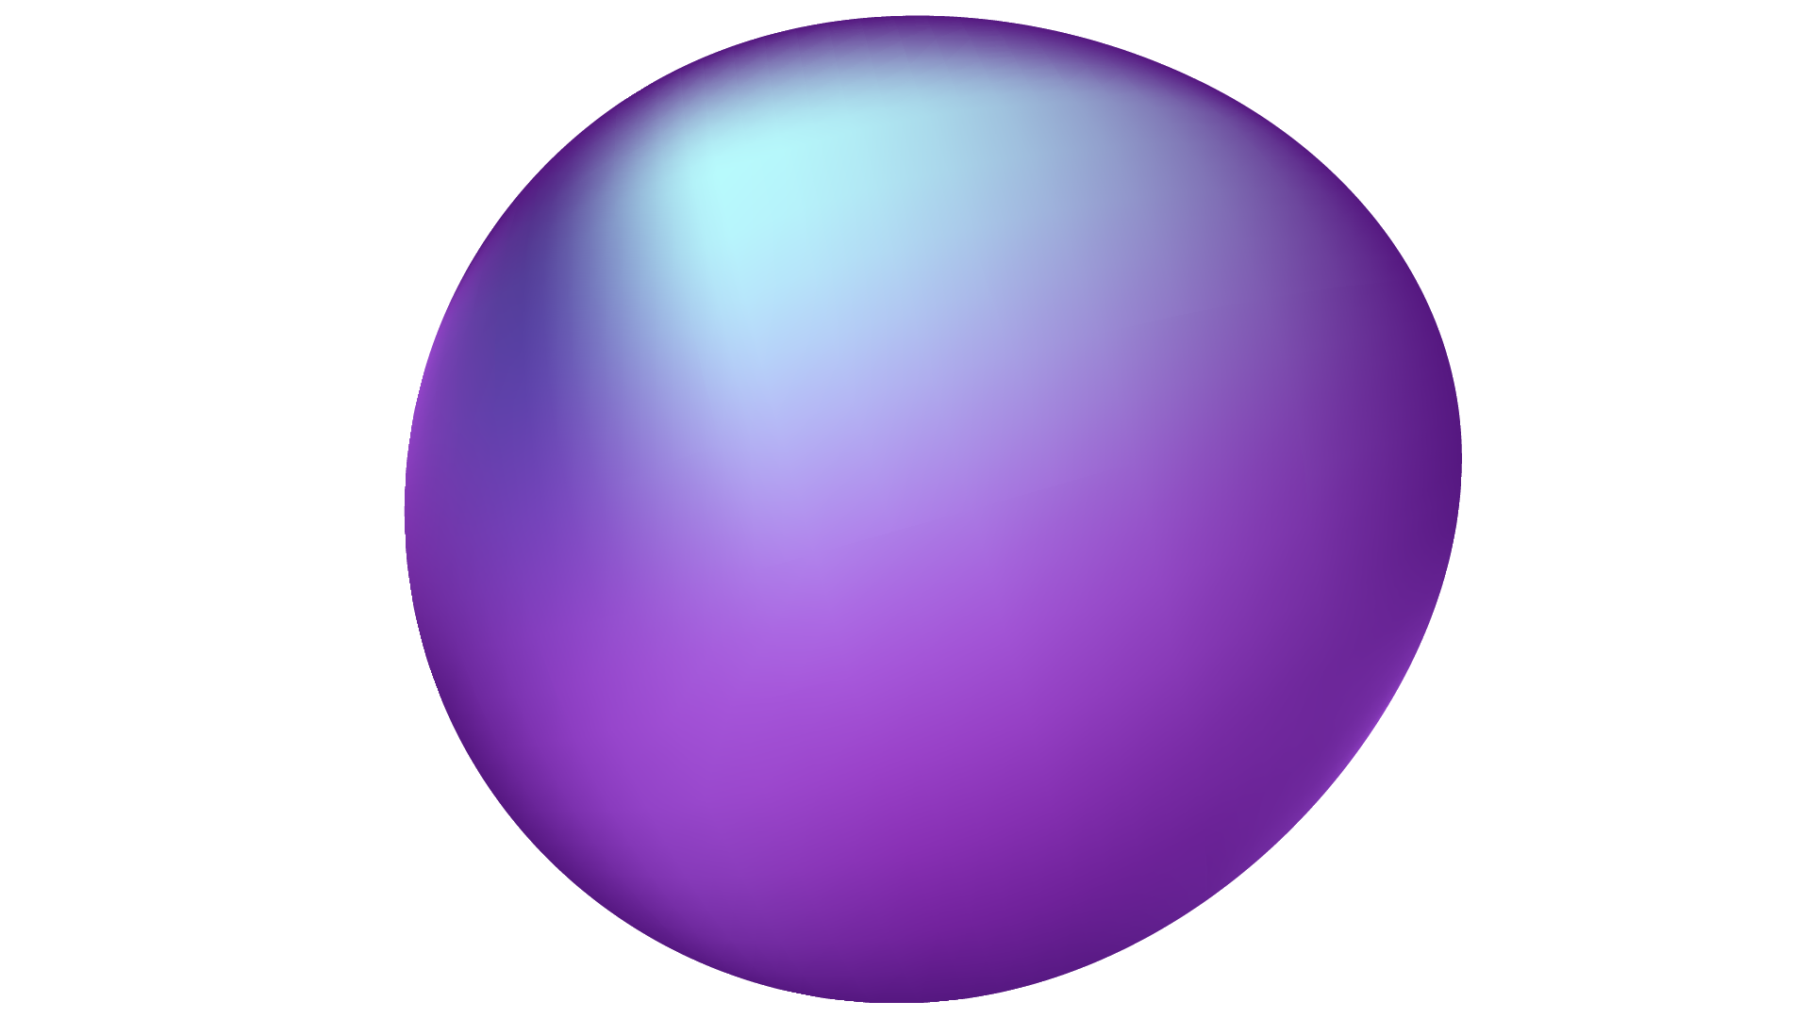
3D IMAGE MODELING

Slide 2
TABLE OF CONTENTS
01
02
03
04
05
OBJECTIF
DATASET
IMAGE TO MULTIVIEW
MULTIVIEW TO 3D OBJECTS
PLANNING

Slide 3
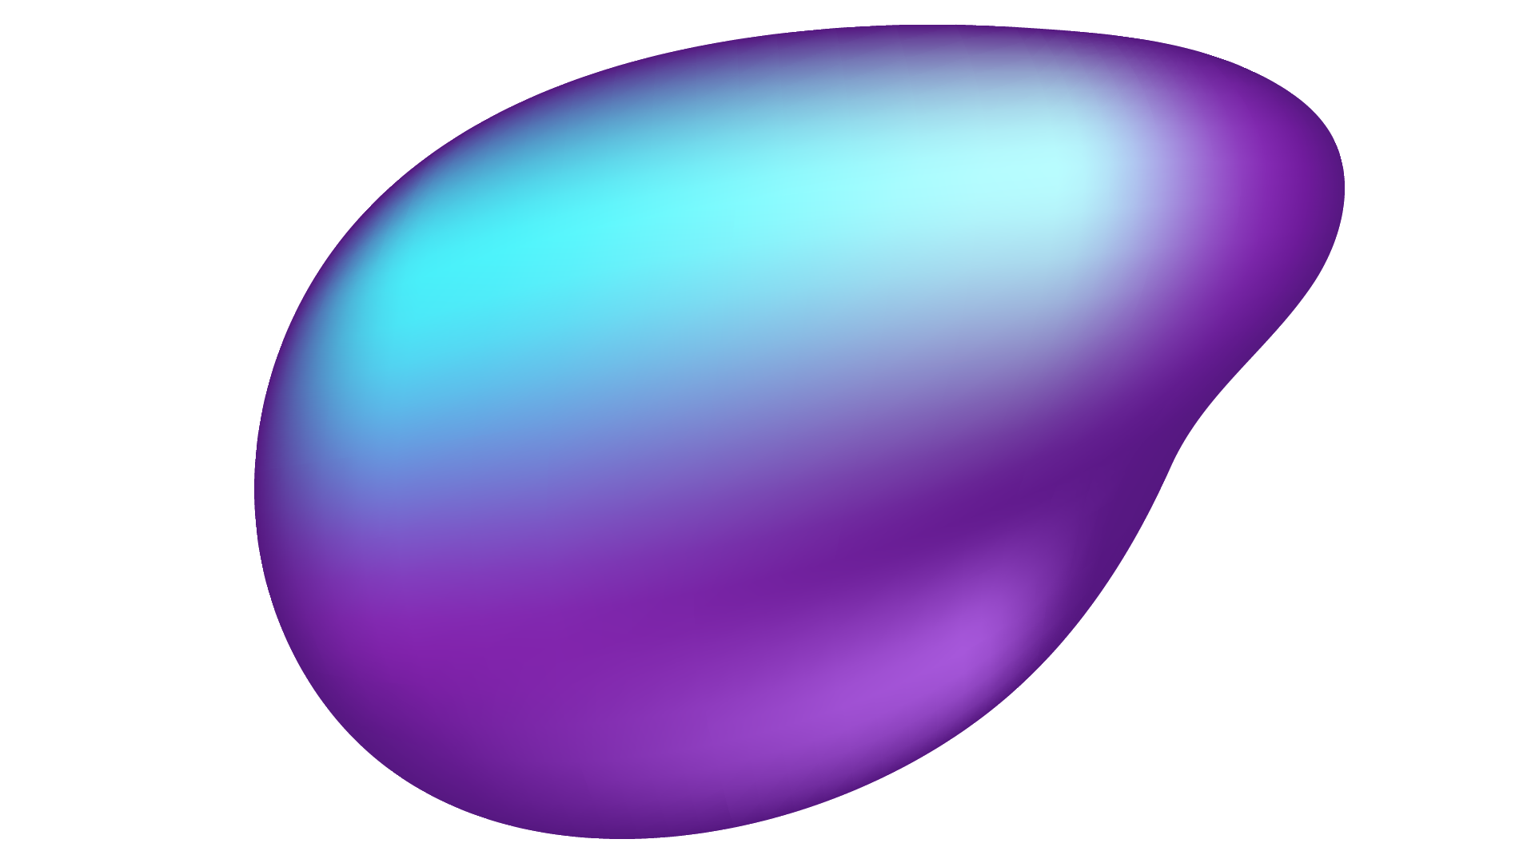

01
OBJECTIF

Slide 4
Our project is focused on the development of an artificial intelligence system that can take a 2D image as input and generate corresponding 3D model automatically

Slide 5
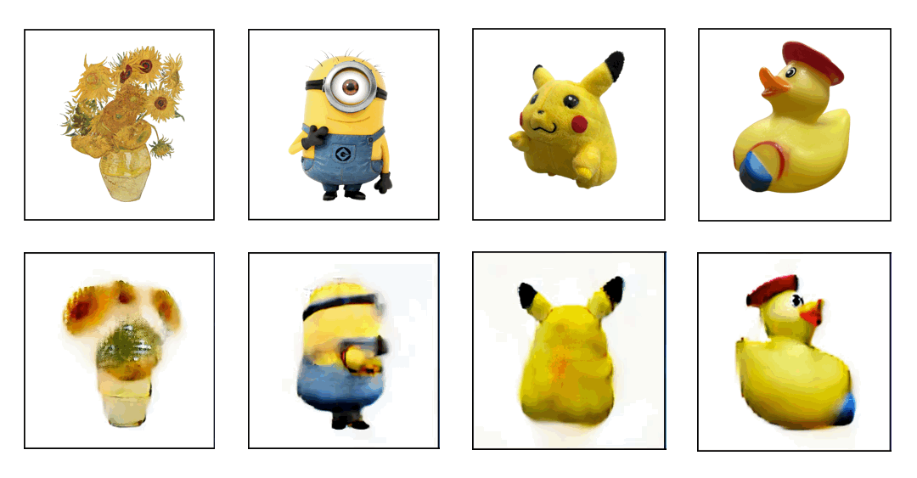
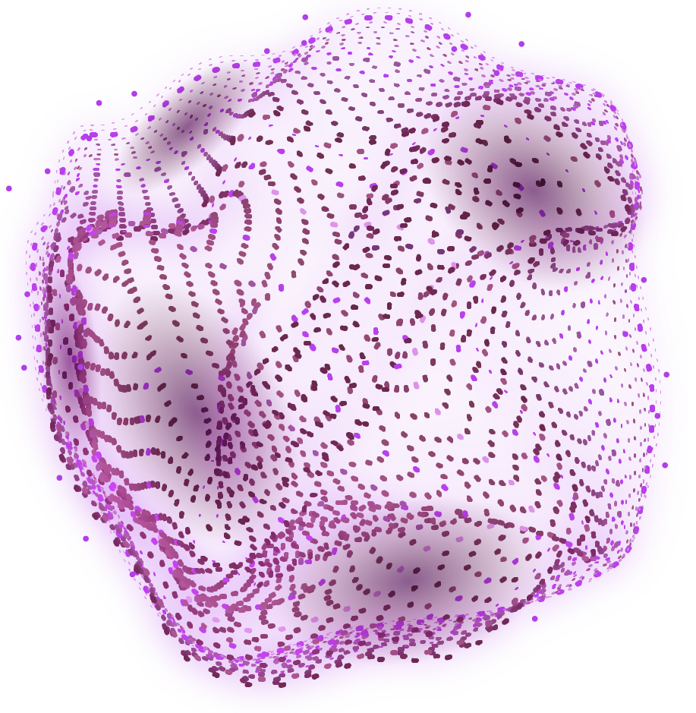
AWESOME WORDS

Slide 6
02
DATASET

Slide 7
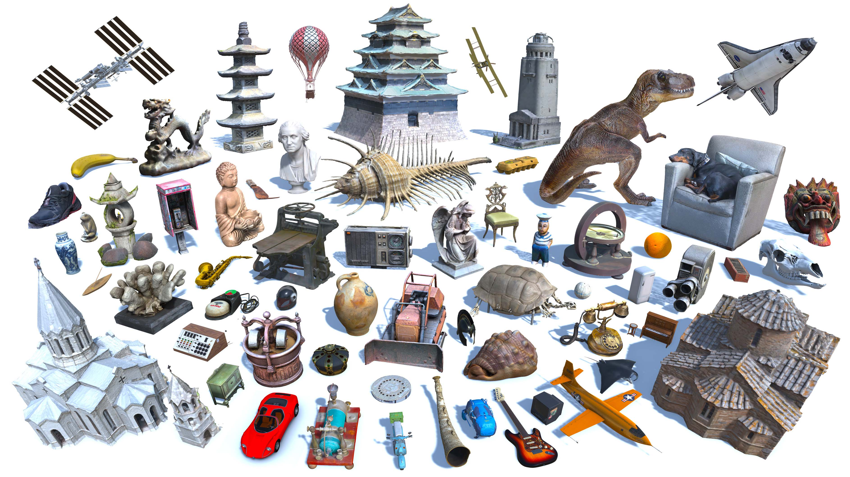
Objaverse is a gigantic dataset of 3D models, mostly sourced from Sketchfab, under a variety of Creative Commons licenses.

Slide 8
03
IMAGE TO MULTIVIEW

Slide 9
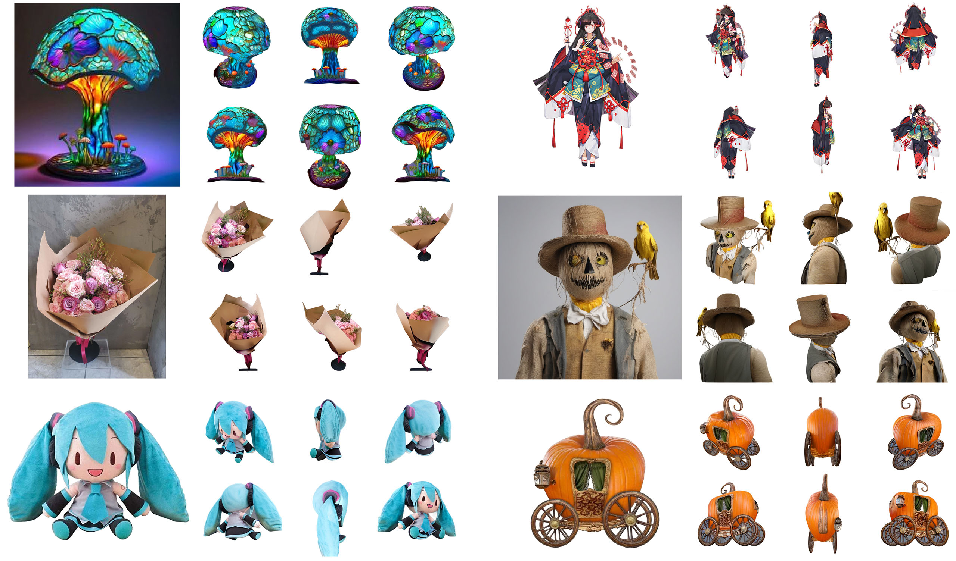
We learn a view-conditioned diffusion model that can generate 3D-consistent multi-view images from a single input view.

Slide 10
04
MULTIVIEW TO 3D OBJECTS

Slide 11
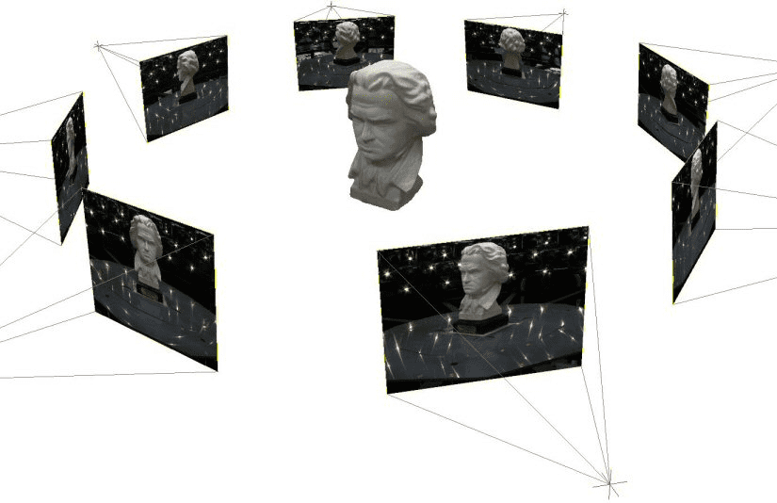
NeRF (Neural Radiance Fields) is a technology released in March 2020. NerF can generate a 3D model from multiple viewpoint images and render any viewpoint video. NeRF does not use polygons, but instead uses machine learning models to represent 3D model representation.

Slide 12
05
PLANNING

Slide 13
TIMELINE
3D objects generation
Project presentation
21/12/23
04/01/24
07/12/23
28/12/23
Multi viewpoint generation
Project report

Slide 14
THANKS!

